Slide 1
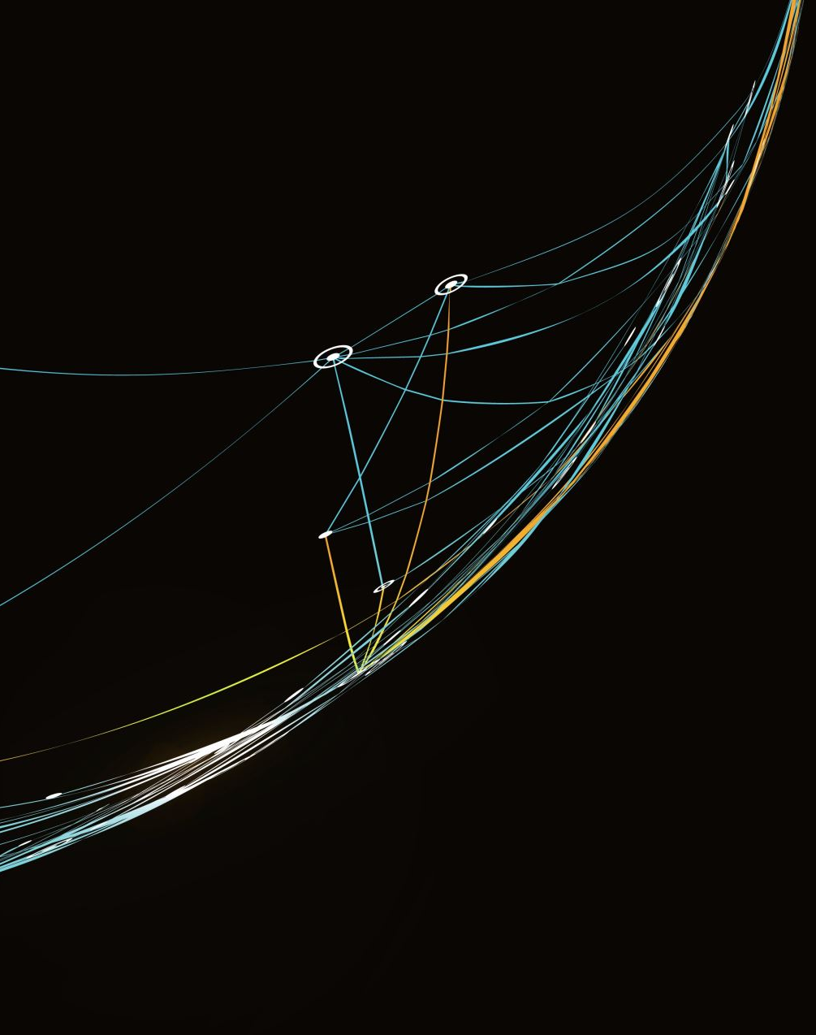
Electronics Store Sales Analytics
Presented by:
Keith Vincent Burca
November 2023

Slide 2

Business Task:
Analyze sales data to gain valuable insights and provide recommendations for the company
Problem: What valuable insights can we get from the data? Time Given: 7 days
Notes:
CRISP-DM (CRoss Industry Standard Process for Data Mining) – iterative framework
Business understanding – What does the business need?
Data understanding – What data do we have / need? Is it clean? Data types, Pre-process, verify data quality
Data preparation – How do we organize the data for modeling? Data munging, cleaning; Select data, trends, patterns
Modeling – What modeling techniques should we apply? Assess model; Iterate model building and assessment until you strongly believe that you found the best model;
Evaluation – Which model best meets the business objectives? Interpret results based on domain knowledge; evaluate, review, determine next steps
Deployment – How do stakeholders access the results? Deploy, monitoring and maintenance, project final report; project restrospective
Deployment is out of scope for this project.

Slide 3
About the Dataset
Column Name | Description
Product | Type of product sold
Quantity | Quantity sold in a particular transaction
Price | Total price of the products sold
Rating | Customer rating
Date | Date of transaction
CustomerID | Unique Identifier for each customer
Region | Region where sale occurred
Discount | Discount in percentage applied to the product
Profit | Difference between price and cost
ShippingCost | Costs associated to shipping and logistics
Color | Color of the product
Weight | Weight of product
Brand | Brand of the product
Warranty | Duration of product warranty in years
14 columns
2,000,000 rows
Duration is from October 16, 2022 to October 15, 2023
Notes:
Data understanding – What data do we have? Is it clean? Data types, Pre-process, verify data quality
Data is recent and is valid for predicting customer behavior in the near future.
We need a tool that can handle 2 million rows.

Slide 4
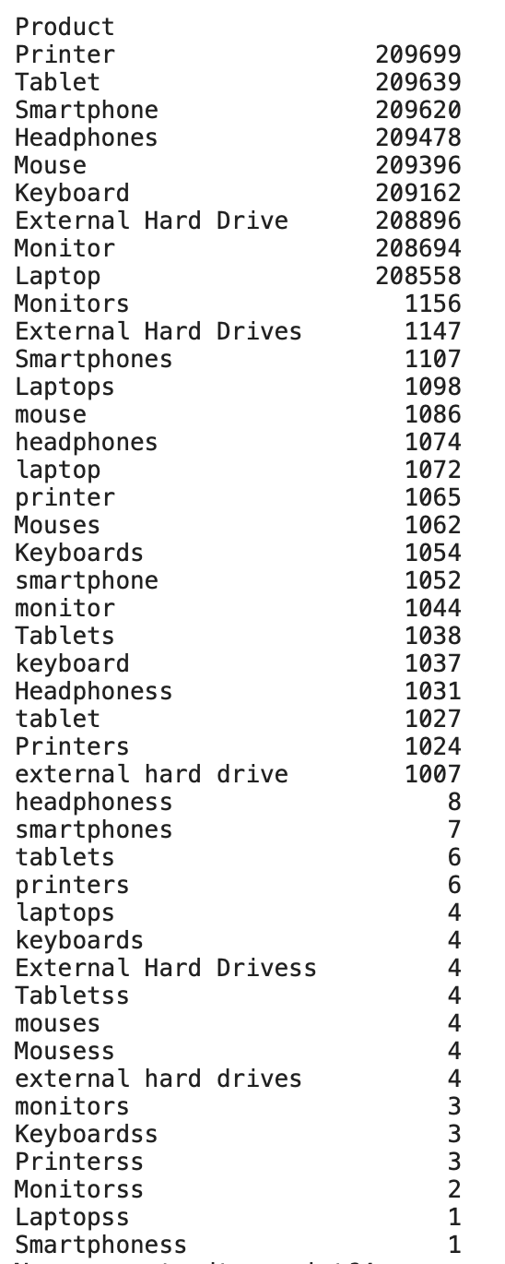
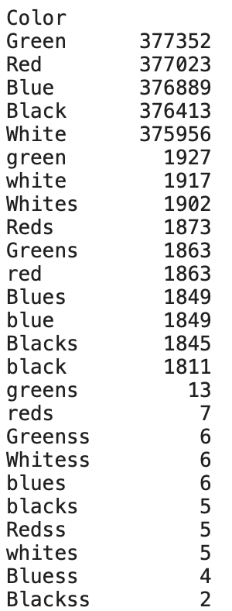
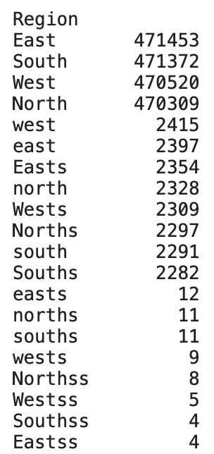
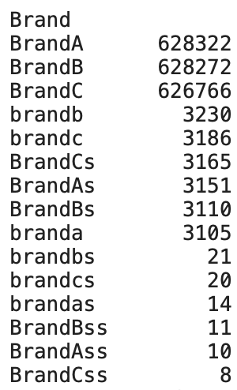
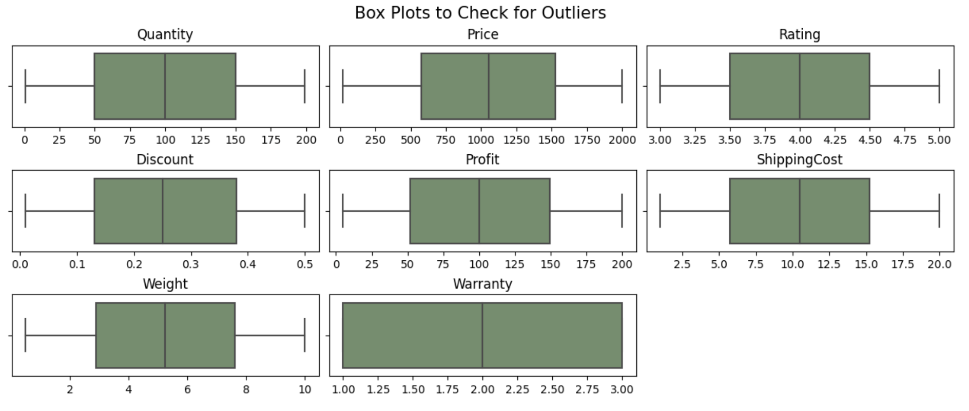
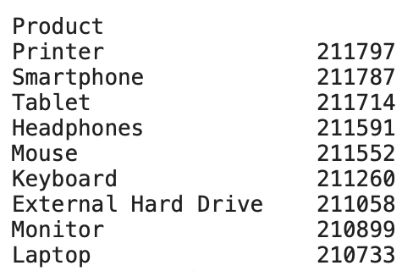
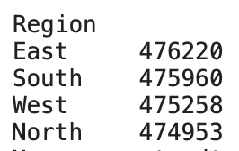
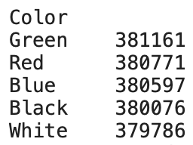
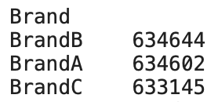
Data Pre-processing
Tool used: Python
Packages: NumPy, Pandas, Matplotlib, Seaborn, Kmeans
No duplicates were found
Removed 97,609 rows with at least one null value
Removed 79,881 rows with Profit value greater than the Price value
Replaced invalid values
Notes:
Data preparation – How do we organize the data for modeling? Data munging, cleaning; Select data; trends, patterns
Box plots show that data has no outliers

Slide 5
Exploratory Data Analysis
Questions to Answer:
Are there products that are performing better than others?
Are there underperforming products?
Are there products that are rated better than other products?
Are there products that are sold seasonally?
Are there unusual patterns that can be seen from the data?

Slide 6
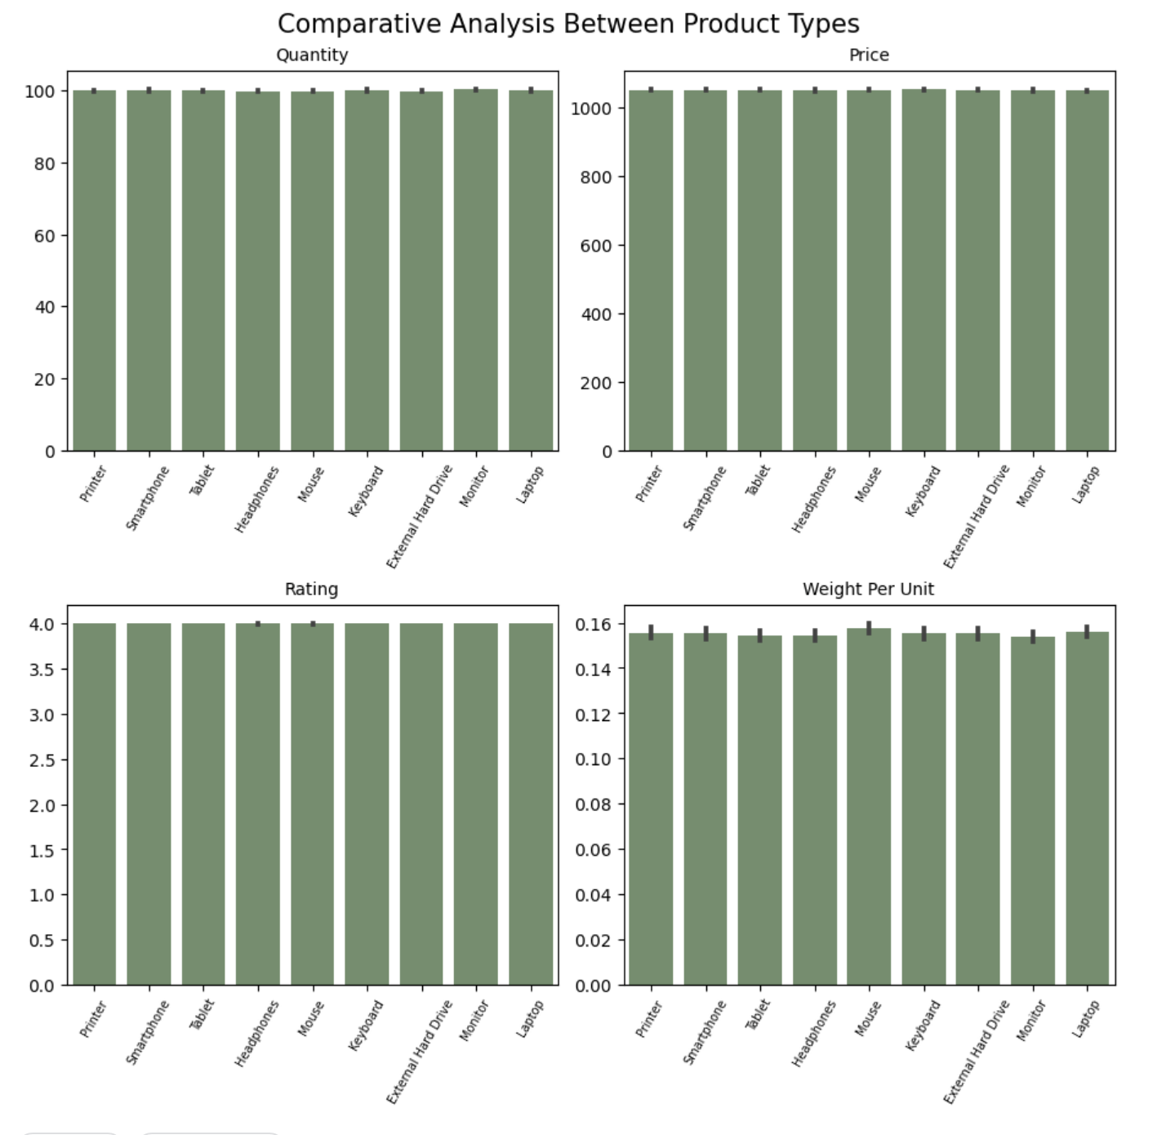
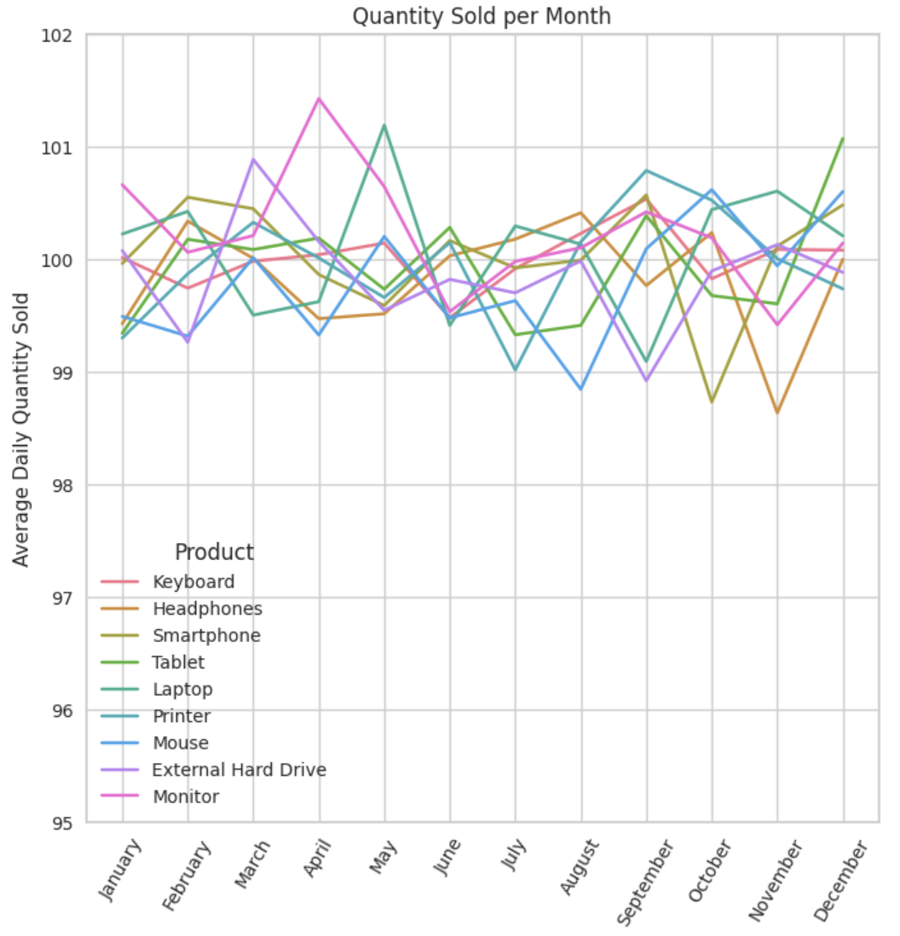
Notes:
Feature Engineering – Weight per Unit = Weight/Quantity
Bar plots - Metrics are nearly uniform across all product types
- including weight per unit - may suggest that certain products have bulkier packaging.
- explore potential packaging optimization opportunities for cost savings in production and inventory, ultimately boosting profits.
Line graph – Mean Daily Quantity sold is around 99 to 101 pcs for all product types. No products are performing better or no products are underperforming.
- No products are sold seasonally.

Slide 7
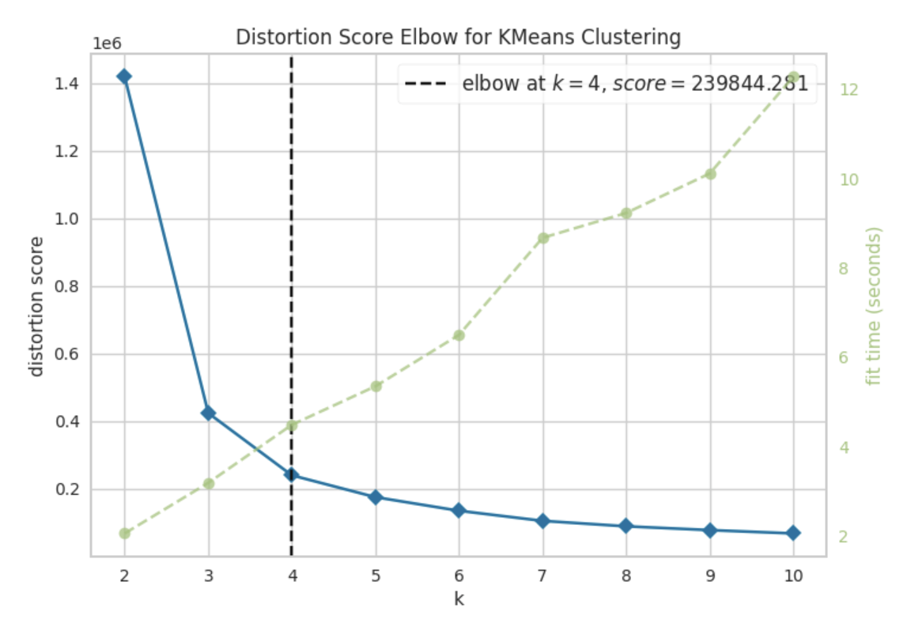
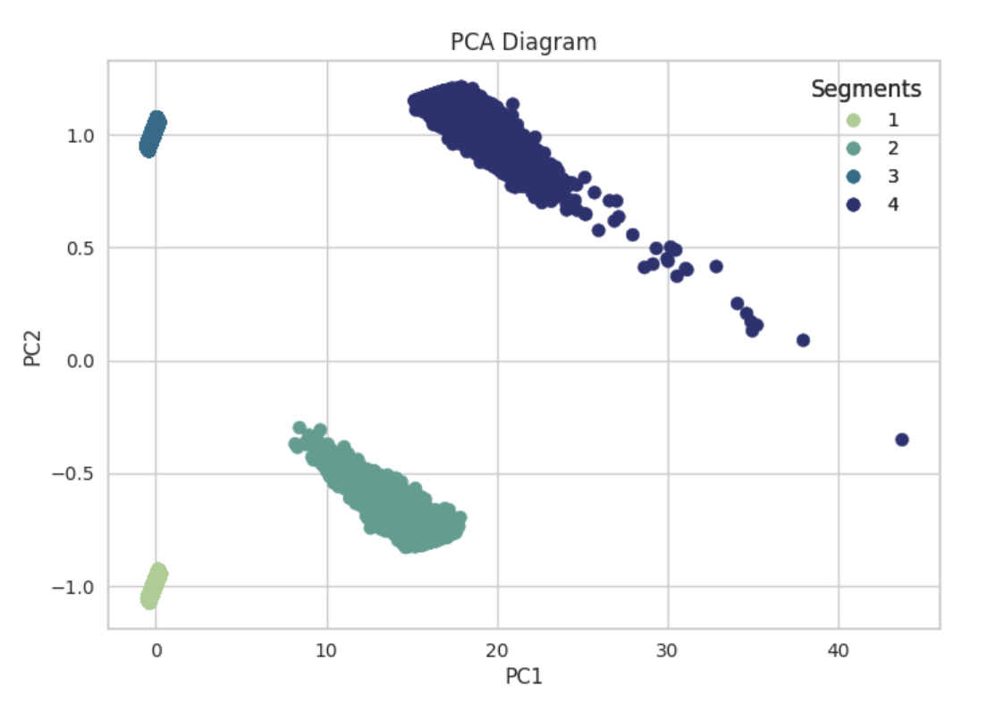
Customer Segmentation
RFM Analysis
tool to evaluate customers
predict customer behavior
tailor marketing efforts depending on which stage they are on the sales funnel
K-means Clustering (k=4, obtained using Elbow Method)
The four segments exhibit distinct characteristics that set them apart from each other
Notes:
Modeling – What modeling techniques should we apply? Assess model; Iterate model building and assessment until you strongly believe that you found the best model
Recency - amount of time since a customer’s last purchase
Frequency - number of times a customer has made a purchase
Monetary - total amount a customer has spent purchasing products
Principal Component Analysis - simplify the RFM components and visually depict the distinctions among the segments

Slide 8
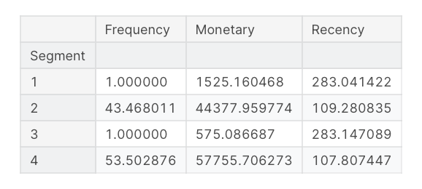
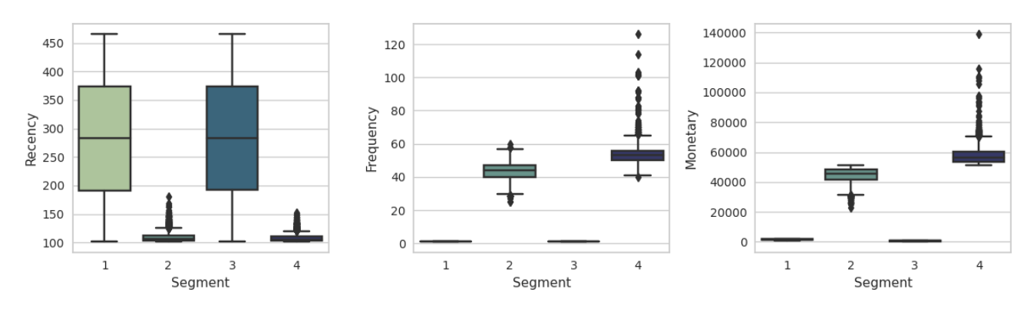
Customer Segments
Label
Explorers
Loyal Customers
Substantial Solo Spenders
Elite High-Spending Patrons

Slide 9
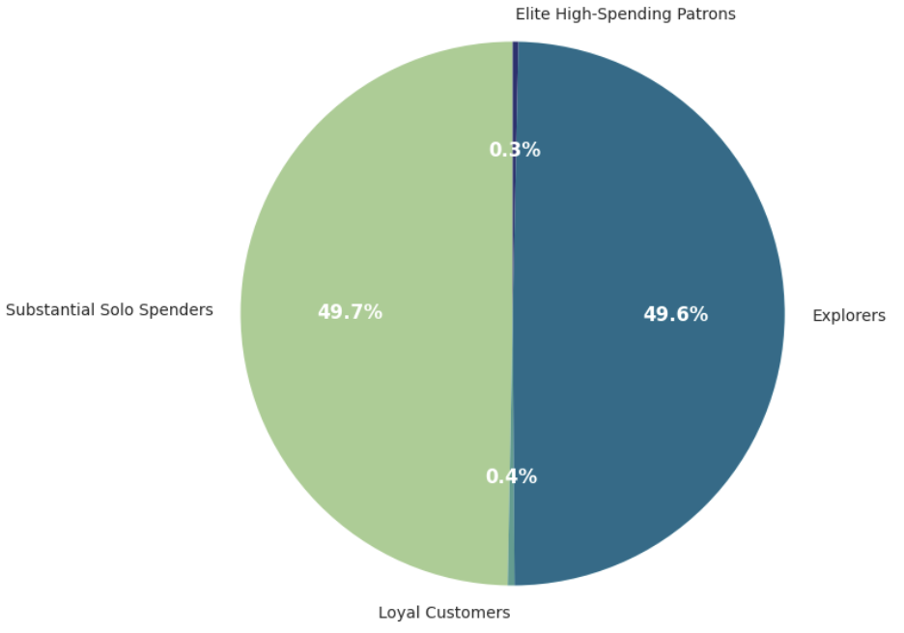
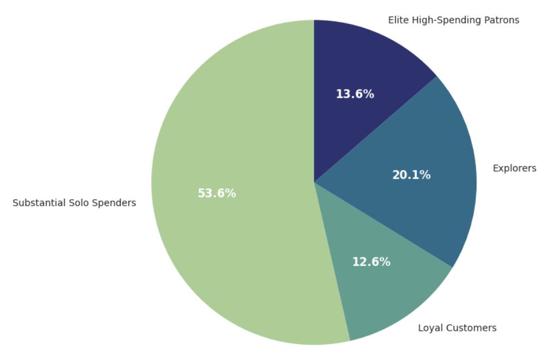
Insights
Customers
Sales
Nearly all of the customers (99.3%) have purchased once only
Elite High-Spending Patrons and Loyal Customers comprise only 0.7% of the total customer base but accounts for about 26.2% of the total sales
One-time Small Spenders, representing 49.6% of the total customers, contributes to only 20.1% of the total sales
Notes:
Evaluation Stage - Interpret results based on domain knowledge; evaluate, review, determine next steps

Slide 10
Recommendations
The company should focus on gaining loyalty from its customers, this can be done by establishing a Loyalty Program
Additionally, tailored marketing strategies are also recommended as follows:
Explorers | Substantial Solo Spenders | Loyal Customers | Elite High-Spending Patrons
Offer introductory discounts to entice first-time buyers | Reward a Welcome Gift or make offers complementary to their past purchase to get them to buy again | Big discounts may be unnecessary, instead promote cross-selling by offering bundles of products | Should be given utmost priority; suggest big-ticket items
Offer special bonuses when a certain spend threshold is reached | Discounts may be necessary, promote cross-selling and upselling | Upsell by offering premium products (e.g. the latest or most advanced model) | Special and exclusive care such as premium loyalty rewards and early access to new collection
Create specific customer journeys aimed at engaging and retaining these customers | Highlight personalized offers, emphasize quality, and showcase additional benefits for loyal customers | Promote premium loyalty rewards which are only enjoyed when a minimum total annual spend is reached | Send Thank-you letters and real-time alerts
Notes:
Incentives from the Loyalty Program might encompass discounts, exclusive access to products or services, or personalized offers tailored to individual preferences.

Slide 11
Further Studies
Optimize the customer segments by:
Trying different clustering models other than K-means, then choose a baseline model
Tune baseline model by adjusting hyperparameters
Along with domain knowledge and business understanding, determine the final model and refine the recommendations

Slide 12
Thank you.

